Slide 1
Mallhalla
A webshop where customers can buy products
(any webshop clone)

Slide 2
Why is this project a good fit for Enterprise Software Development?
Since the concept is simple and well known, it should be easy for me to find help if I get stuck.
This project allows me to touch all the learning outcomes.

Slide 3
Why is this project a good fit for Enterprise Software Development?
LO3: Scalable Architectures - I can split the application up into multiple services
LO4: Development and Operations - I can test and deploy the app
LO4: Targeted Interaction – work agile. GDPR user data
LO5: Cloud Native - run any container in cloud
LO6: Security by Design - Solve security risks from OWASP top 10
LO7: Distributed Data - Protect sensitive data, maybe encrypt it, substantiate the reason why you choose a certain database. Distribute my data in multiple databases.

Slide 4
Non-functional requirements that are important to my project
When using the search engine. It should return results within 1 second.
The website should be able to handle 1000 consecutive users. (Automatic horizontal scaling)
Sensitive data should be protected and encrypted or obfuscated or both
The application / a service can't just run into an error and stop running
UI must be easily understandable consider UX testing

Slide 5
Technologies
Backend: C# .NET, I would like to enhance my skills in this language.
Frontend: React TypeScript Node/Next or C# .NET Razor Pages. I have little experience with both.
Database: Don't know yet needs research
Communication Protocol: Probably messaging but needs research
Cloud: Research
Auth: Research

Slide 6
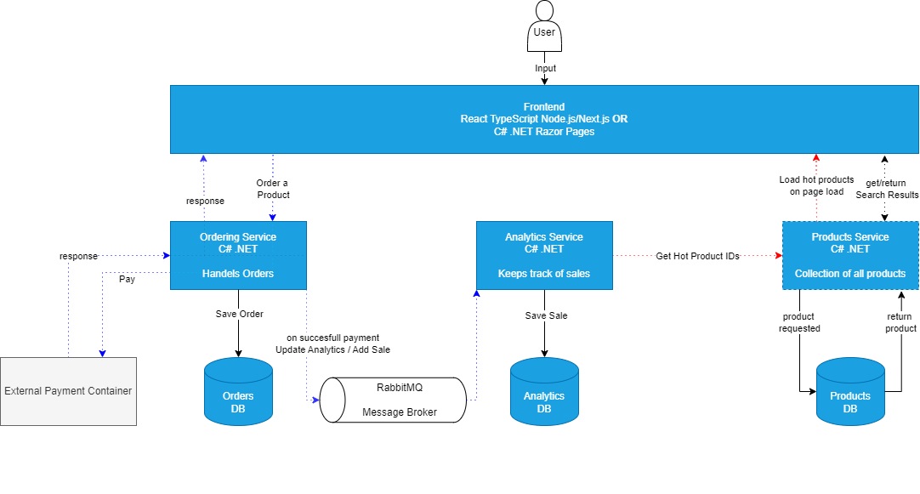
Architecture

